Slide 1
Cancer Care Ontario
Jack Guo, Peter Zeng

Slide 2
Problem Statement
Jonathan Wang is tasked with allocating linear accelerators for a 5-year period between 2013-2017
Cancer Care Ontario has been expanding and building new facilities during the past decade due to increasing demand for cancer care
Need to ensure quality treatment throughout province by meeting cancer care demands for all regions

Slide 3
Assumptions
Empty rooms and swing rooms can be used interchangeably
Alternate: they will be treated as separate types of rooms
Rejection reason: most facilities only have either empty rooms or swing rooms, not both
Recommended new machine quotas are “use-it-or-lose-it”
Alternate: difference between recommended amount and actual number of linacs added can be used in future years
Rejection reason: will be considered in sensitivity analysis
Forecasted demand is accurate (forecast = actual)
Alternate: make actual demand different from forecasted demand
Rejection reason: no information available on historical demand data
Notes:
Example of “use-it-or-lose-it”: it was recommended to add 4 machines province-wide in 2013, but only 3 more were added. You can’t add 1 extra machine on top of the recommended amount for future years. As part of sensitivity analysis, the 1 leftover “slot” can be moved to a future year.

Slide 4
Assumptions Cont’d
Assume Cancer Centre with adjacent numbers are adjacent geographically, meaning that patients from number 2 can also go to 1 or 3.
Alternative: patients can only go to local centre
Rejected Reason: Not realistic and hard to implement in the model
Assume the portable linac can move from each centre to another in anytime during a year, meaning that the portable unit can fulfil those segmented unmet demands from centre to centre, which adds up to a maximum of 426.

Slide 5
Model Development
Decision Variables: the number of new linacs added in each centre by year
Quota Constraint: total amount of new machines added across province each year cannot exceed RTCIS recommended quota
Demand Constraint: treatment capacity must match treatment demand across all 16 centers throughout province
Room Constraint: the added machine in each Cancer Centre cannot exceed their available rooms.

Slide 6
Method
Instead of using Linear Programming, manual trials are used to find the best allocation for 2 reasons: 1. No clear objective function is defined in the question, 2. The number of added units each year is small.
Two tables are introduced in our case, one called capacity gap, showing the excess capacity in each centre, the other is called overflow, showing the unmet demand in each centre.
By changing the number in the decision variable cells, we try to minimize the unmet demand to 0 by moving the excess capacity from adjacent centre and add new linacs

Slide 7
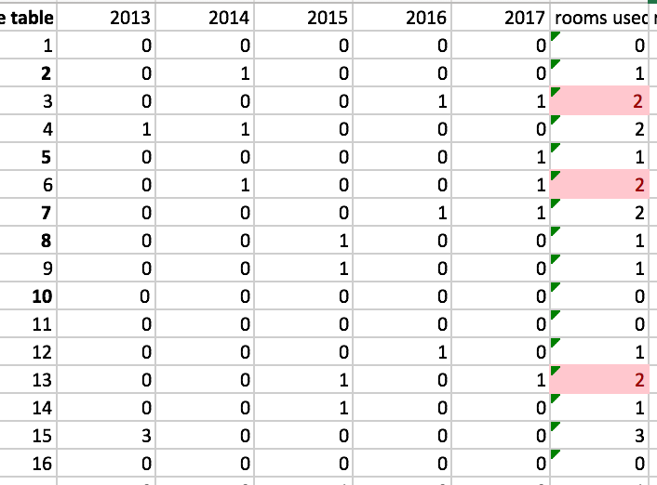
Base Solution

Slide 8
Base Solution
From what we’ve got from Excel, it is impossible to meet all the demands under the assumptions and constraints made.
So we changed the room constraint just to meet all demand constraint.
As a result, 4 new units in 2013, 3 in 2014, 4 in 2015, 3 in 2016, 5 in 2017 are needed. Therefore 2 more rooms are needed than the original capacity of 16.

Slide 9
Sensitivity Analysis
Premise: if added machines below RTCIS recommended amounts, leftover “quotas” can be moved to future years (e.g. if only 3 linacs are needed in 2013, the quota for 2014 will raise by 1 unit.)

Slide 10
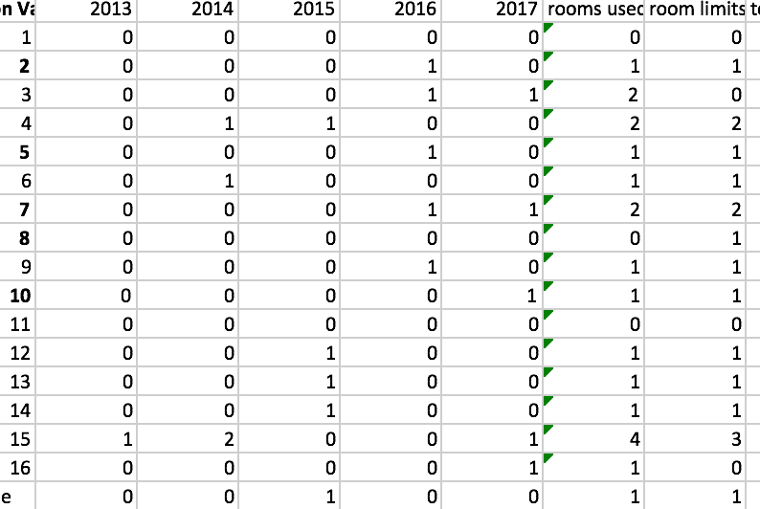
Result

Slide 11
Result
Compared to the base solution, usage of portable units is lower.
Still 2 more linacs compared to room limits are needed.

Slide 12
Conclusion
More rooms (e.g. 2) are needed to satisfy demands

